Slide 1
Effectiveness of adversarial examples on convolutional neural networks
Presented by
Rafael Possas,
Research Engineer at Centre of Translational Data Science, University of Sydney
Master of Information Technologies (Research)

Slide 2
Contents
Goals
Approach
Results
2016 data
2017 data
Next Steps – Year two activities.

Slide 3
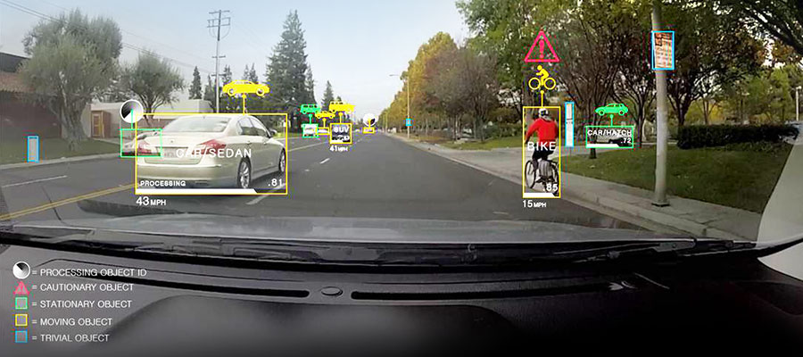
What is Computer vision?
“ Computer vision is an interdisciplinary field that deals with how computers can be made to gain high-level understanding from digital images or videos” - Wikipedia
Example of object segmentation on a self-driving car [1]

Slide 4

Convolutional neural networks
“Type of feed-forward neural network which the connectivity pattern is inspired by the organization of the animal visual cortex” [2]
It provides state of the art performance on data with spatial structure [1].
An example of CNN architecture, VGGNet [3]

Slide 5
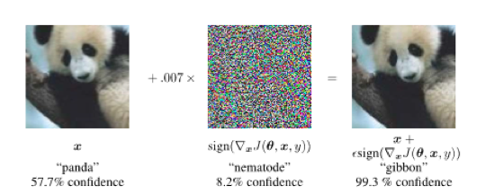
Adversarial inputs
Intentional modification on inputs to deliberately yield erroneous model outputs, while appearing unmodified to human observers.
Depend on model information to successfully generate an adversary
Adversarial crafting using Gradient Sign from Goodfellow et al. (2014) [3]

Slide 6
Imbalanced learning and domain shift
Imbalanced Learning: When the underlying training set contains high variance on the number of samples for each class.
Domain Shift: When the joint distributions of inputs and outputs differs between training and test stages.
Imbalanced Learning
Domain Shift
enforces

Slide 7

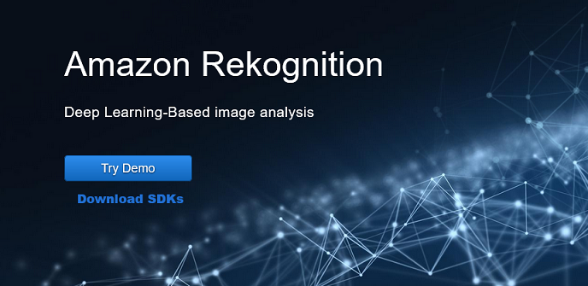
Motivation
Image recognition systems have been used widely in commercial applications
Adversarial attacks are proven to work on state of the art convolutional neural networks (CNNs) architectures.
Real world data is often imbalanced with lots of missing values
There is no empirical evidence of adversarial attacks on class-imbalanced CNNs

Slide 8
Research question
Would adversarial attacks be more effective on networks trained on Imbalanced datasets?
Does the attacks heavily depend on the targeted model internal knowledge?
Does classes with similar and different features space behave equally to adversarial attacks?

Slide 9
Contributions
Evaluation of the resilience of imbalanced CNNs to adversarial attacks using the white-box and black-box approach
Investigation of classes with overlapping distributions and their relationship to both adversarial attacks and imbalanced learning problem

Slide 10
Experiment design (1): CNN Architecture
First architecture to show that the depth of a network its critical to its performance
Homogeneous architecture: Only 3x3 convolutions and 2x2 pooling from beginning to end
We’ve changed the architecture to cope with the smaller input size (32x32).
Change: Two 4096 FC => single 512 FC layer
Change: 3 Convolution/pooling blocks instead of 4.

Slide 11
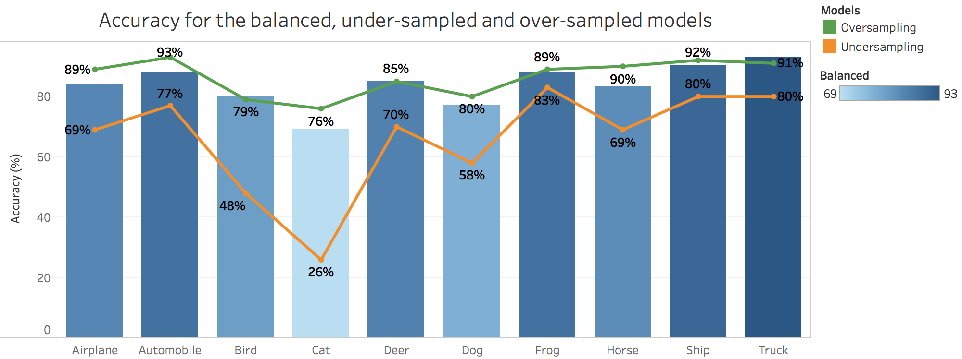
Experiment design (2): Imbalanced dataset
CIFAR-10, 32x32 images on 10 non-hierarchical classes, 60,000 samples
Modified VGG: achieved 83% overall accuracy on the balanced dataset
Baseline: Balanced dataset vulnerability to adversaries
Tests: 20 different imbalanced variations with under-sample and over-sample on each of the 10 classes

Slide 12
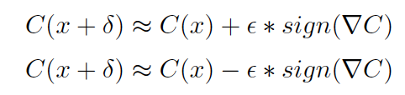
Experiment design (3): Gradient sign method
Uses the gradient of any chosen class to add small noise to image pixels
Only the gradient direction is used, due to the sign operation, the magnitude of the perturbation is controlled by the epsilon
Fast gradient sign x Iterative gradient sign
Ascent x Descent perturbations
Epsilon 0.01: Best trade-off between misclassification and image noise
Methods: Fast gradient sign and ascent perturbations
Backpropagated gradient: True class
Intuition: Increase the cost function of the true class by the epsilon value in all gradient directions

Slide 13
Experiment design (4): White/Black-box attacks
Same model gradient (White-box): Uses the underlying model knowledge to create optimal perturbations
Different model gradient (Black-box): Uses an approximation of the true model, in this experiment, represented by the balanced network.
Same data domain but datasets vary on the total number of samples.

Slide 14
Approach
Investigation of of Dataset and Analytical Methods
Cleans and pre-process data
Model Development and Training
Model evaluation
Missing values and payment distribution over time required joint investigation with DOI stakeholders.
The application of Long short-term networks, a neural network method for time series prediction
Learns trends and relationships between data points over time
Model will reach optimal performance as more data is collected.

Slide 15
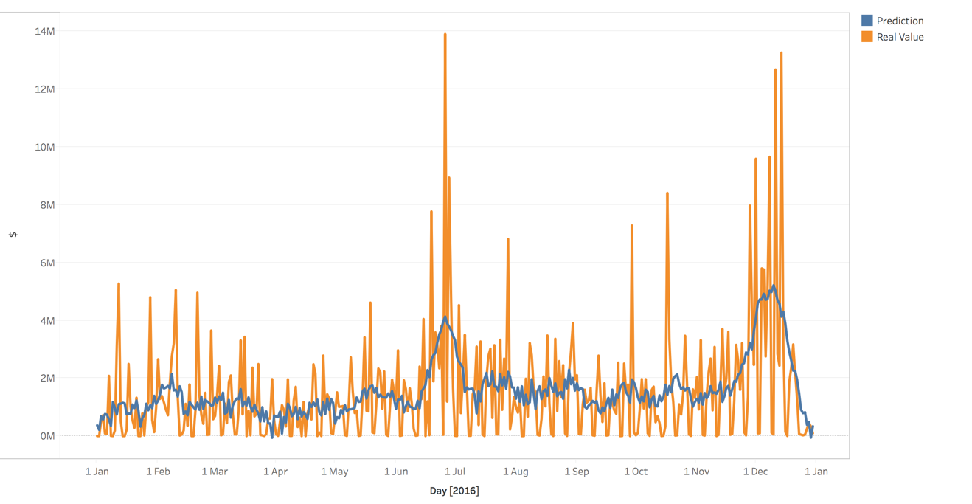
Results on 2016 data
Learning the temporal structure of the data – trends and spikes.
Performance:
$7.8M RMSE – 1% deviation with respect to the total budget
Variance of 8% over monthly absolute values

Slide 16
Results on 2017 data – Comparison with Finance Forecasts
11% variance on 2017 data
The LSTM follows a trend while the finance model uses a moving average

Slide 17
Results on 2017 data – Cumulative perspective
Cumulative graph illustrates that the differences (caused by adjustments) with Financial Actuals and Subsidy payment iron over time.

Slide 18
Next steps – Year two activities
Work closely with the subject matter experts within the department in order to further analyse and understand the intricacies of the data flows.
Work with the finance team to develop improvements to their bottom up approach model
Create an allocation process that is able to track 2017 providers in terms of expending their allocations by January 2018 – aim is to simulate levels of change.

Slide 19
Questions?

